Slide 1
可信软件开发方法 Course 1
李 钦
2019

Slide 2
outline
可信软件
形式化方法在可信软件开发中的角色
Event-B介绍

Slide 3
何为可信软件
软件系统的行为符合用户预期
软件自身的行为
软件与环境的交互行为
特殊情况下的软件行为
可信指标：
正确性
可靠性
安全性
可用性

Slide 4
可信软件的挑战
软件是复杂的
软件规模和应用领域的不断扩大
软件需求的不确定性
软件项目的管理成本和风险
Bug，软件正确性、质量的要求

Slide 5

软件的复杂性
规模大、组件多、关系复杂
交互频繁、行为动态
运行环境的不确定性
功能与效率的权衡
软件安全

Slide 6
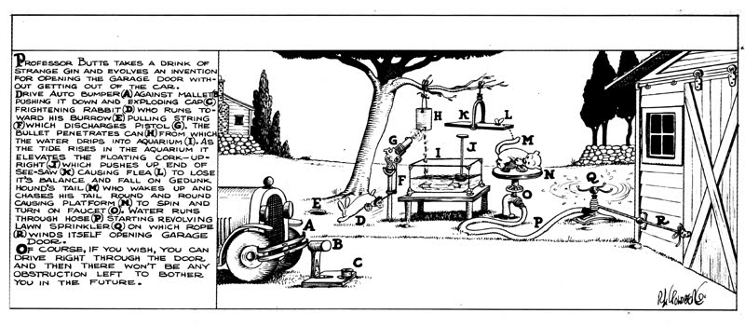
A Garage door open design

Slide 7
Actual design

Slide 8
ATM Machine

Slide 9
ATM Machine

Slide 10
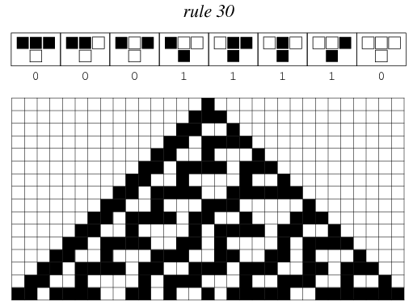

Complex from simple
Cellular Automata
Each cell follows the very simple rule depending on their neighbors
After large number of generations, interesting patterns emerge
Swarm Intelligence
bird flocking
ant colony
Swarm Robotics
UAV formation
self-assembling robots

Slide 11
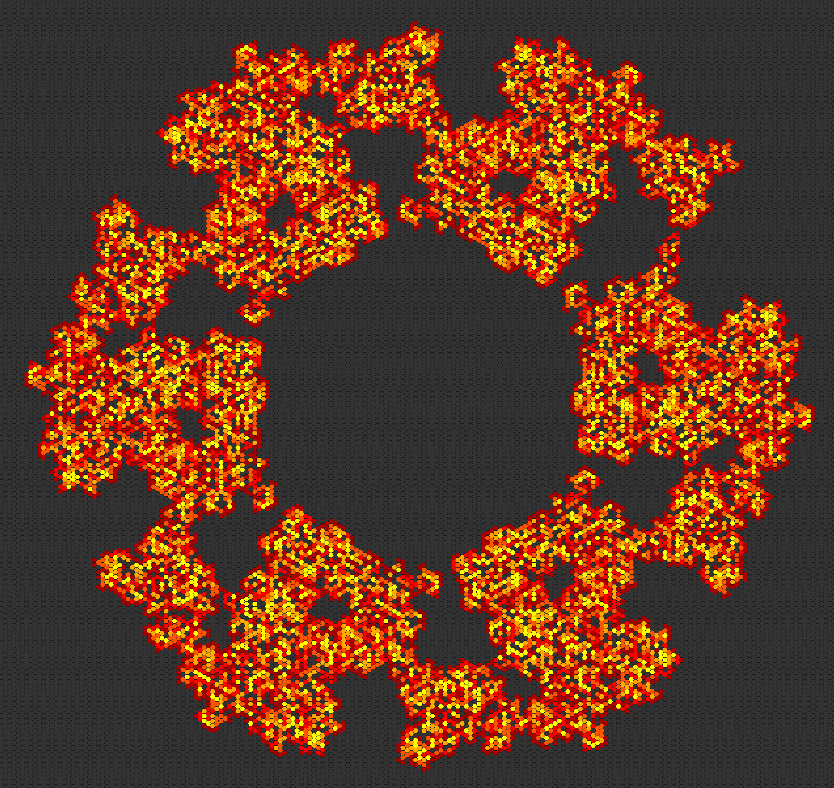
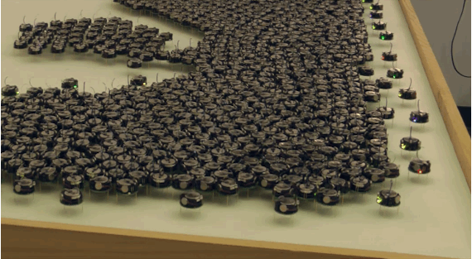

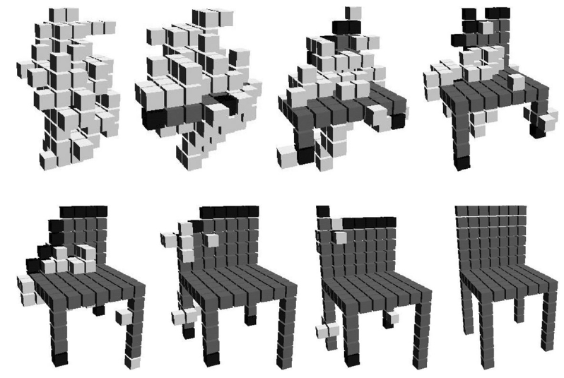
Examples
Animation of first 200 steps of Langton's ant

Slide 12
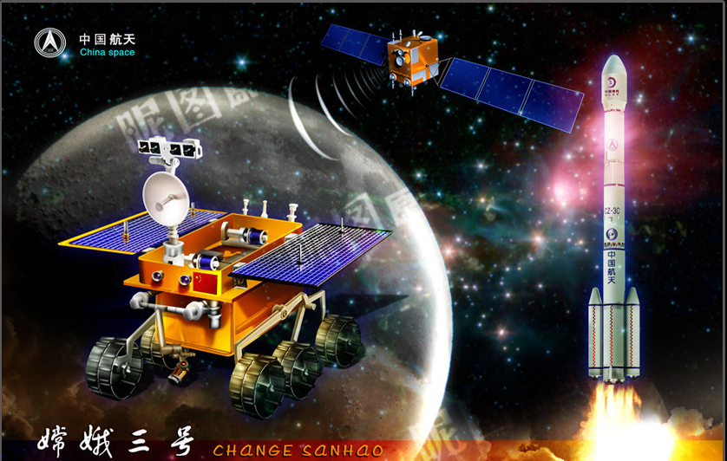

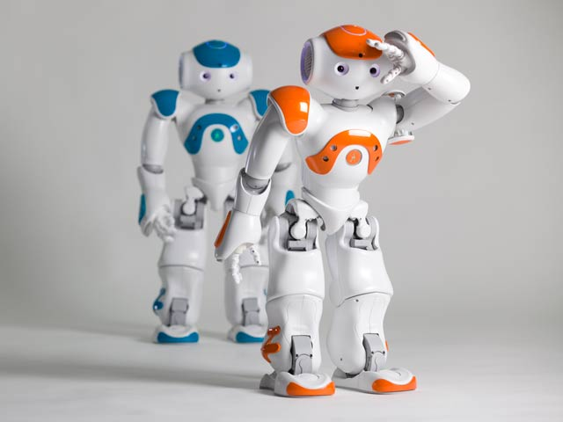

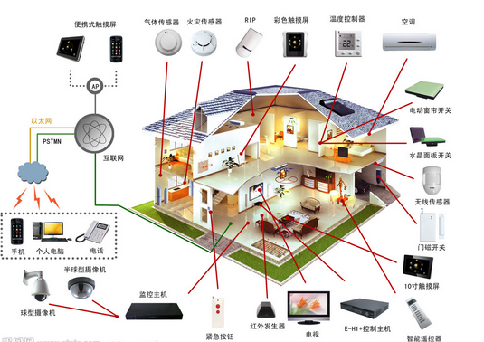
应用领域多样
系统软件、应用软件
科研、军工、商业软件
生产、生活、服务、娱乐行业
大型机、PC机、平板电脑、手机、嵌入式设备
人工智能、可穿戴设备、虚拟现实

Slide 13
软件工程第一定律
软件工程师
需要足够了解应用需求

Slide 14
软件需求的不确定性
用户需求与程序设计的鸿沟
需求的不定期变动
对软件本身和软件环境的划分
需求本身的相容性
Problem
Software
Requirements
Specification
Program
Describes
Specifies
Analyzes
Develops
Customer
Software Engineer

Slide 15
软件管理成本与风险
软件过程模型 | 风险
WaterFall | 设计变动困难
Evolutionary | 可视性差，难以预测
Spiral | 风险控制成本极高
Transformational | 需要形式化建模专家

Slide 16
软件正确性和软件质量
Bug、漏洞无处不在
软件实际行为与需求不一致
软件运行时错误
软件测试与维护成本居高不下
软件的正确性和安全性保障刻不容缓

Slide 17
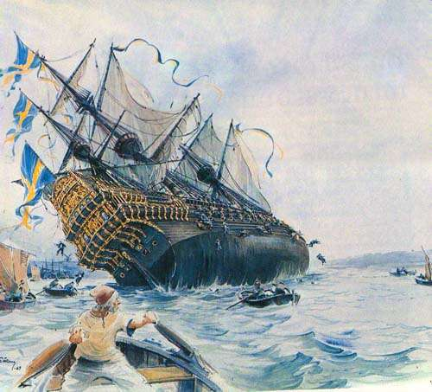
Case 1: The Vasa Sink
one of the most powerfully warship in the world
sink on its maiden voyage on Aug 10,1628
53 lives lost

Slide 18
Problems for vasa
Changing requirements frequently
No specification for construction of the modified keel
Lack of explicit design
No scientific methods for calculating criteria of the ship
Test outcome was neglected

Slide 19
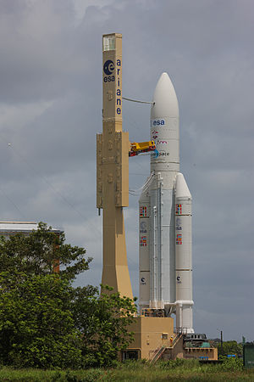
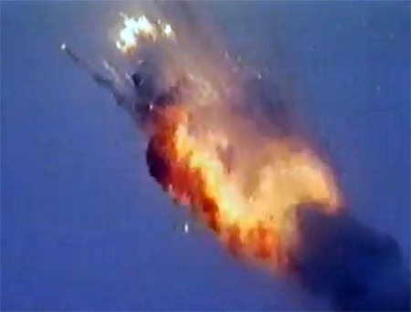
Case 2: Ariane 5 disaster
European heavy lift launch vehicle
Exploded in its maiden launch on June 4, 1996
a decade of development costing $7 billion
$500 million lost

Slide 20
Problem for Ariane 5
Both inertial computers failed because of overflow on one variable
The faulty program was working correctly on Ariane 4
The faulty program was not tested for A5
the velocity of Ariane 5 is far greater than that of Ariane 4
The faulty program happened to be useless for Ariane 5

Slide 21
软件工程方法的目标
在用户和软件开发人员之间建立桥梁
精确描述用户需求
使软件具有良好的重用性和可扩展性
支持软件的模块化开发与维护
精确完善的软件文档，减少管理成本
保证软件正确性，减少软件Bug，提高软件质量
Software Engineering

Slide 22
如何保证软件可信性
软件需求
形式化描述软件需求
减少需求中的不确定性
软件设计
形式化模型对软件系统进行分解和建模
采用精化理论对系统进行基于模型的形式化开发
自动代码生成
软件验证
程序静态分析
模型检测
定理证明
软件测试
单元测试、集成测试
白盒测试、黑盒测试

Slide 23
形式化方法介绍

Slide 24
形式化方法
判定程序是否具有期望性质的系统方法
精确的数学语言
合理的抽象
严格的推理与证明规则
软件工程方面的应用
对软件需求进行精确建模与描述
通过模型转换进行形式化软件设计与开发
对软件行为是否满足需求规范进行推理、证明和验证

Slide 25
软件生命周期
Requirements
Design
Implementation
Verification
Maintenance
Requirement Specification
Software Architecture
Software code
Testing
Software Support
Formal Specification
Formal Model
Code from model transformation
Model checking and theorem proving
Software Support

Slide 26
形式化软件开发终极目标
Formal Development
Formal Specifications
由用户需求到软件代码的自动生成
生成的程序代码符合用户需求
特点：
精确定义用户需求，保证一致性
通过数学证明保证设计与开发的正确性
从模型到代码的自动转换
Requirements
Translate
Refinement
Intermediate Formal Models
Verify
Refinement
Generate
Programs
Implementation Models

Slide 27
主要的形式化方法分类
Type Checking
Static Analysis
Model Checking
Theorem Proving

Slide 28
Type Checking
类型：
a set of values to be assigned to a variable
operations that can be performed on a variable
the way a variable will be stored in the memory
目标：
value assignments to a variable are correct
variables used in authorized operations only
实现：
automatically within the compiler design

Slide 29
Static analysis
Typical run-time errors:
division by zero
array bound overflow
arithmetic overflow
目标：
checking that a program will not have certain run-time errors
实现：
abstracting the program variables and executing the abstraction

Slide 30
Model checking
Model: finite state machines
Property: temporal properties
目标：
checking that the model of the program satisfy the temporal property
实现：
Model checkers
working automatically

Slide 31
Theorem proving
Constructing models by successive refinements
Properties to be proved:
invariants of the model
refinement of the model
目标：
translating the requirement to a model design
translating the most refined model to a program
实现：
Model driven development with Refinement theory

Slide 32
Event-B介绍

Slide 33

Event-B
一种软件形式化建模与开发方法
在B方法基础上发展出来的 基于状态和事件的形式化系统
支持基于精化的模型转换和性质证明
创始人：Prof. Jean-Raymond Abrial
工具支持：Rodin
网站：http://wiki.event-b.org/index.php/Main_Page

Slide 34
correct by construction
Requirement
Modeling
Refining
Proving
Informal (but precise) requirements
Modeling (not programing)
Refining
Proving

Slide 35
Requirement
Properties of the system
Assumptions about the environment
Allowing us to judge eventually that the final product is correct
Made of short labeled fragments
Should be easy to read and easy to extract

Slide 36
example: Bank
Actors:
An account contains some information:
This system involves accounts and persons
ENV-1
An account has a balance: a positive and limited integer
ENV-2
An account has an owner: a person
ENV-3

Slide 37
Example: Bank
Basic Event:
An account can be opened or closed
FUN-1
When an account is closed, its balance must be 0
FUN-2
Money can be deposited or withdrawn on an account
FUN-3

Slide 38
Example: Bank
More Event:
Money can be transferred from an account to another
FUN-4
People can save money by transferring it from a normal account to a savings account
FUN-5

Slide 39
Modeling vs. Programming
A model is like a blue-print in other engineering disciplines
Modeling should allow us to reason about a future system
A model is not a program
A model is an abstraction of a program
The basis is lacking: a model cannot be executed

Slide 40
Model construction
The model should contain the required properties
Each fragment of the requirements should be reflected
Formal notations in order to facilitate reasoning
Classical Logic (Predicate Calculus)
Basic Set Theory (Sets, Relations, Functions)

Slide 41
Systems we are interested
“Classical” software
an electronic circuit
a file transfer protocol
an airline booking system
a PC operating system
a nuclear plant controller
a smart card electronic purse
a launch vehicle flight controller
a driverless train controller
a mechanical press controller
etc.

Slide 42
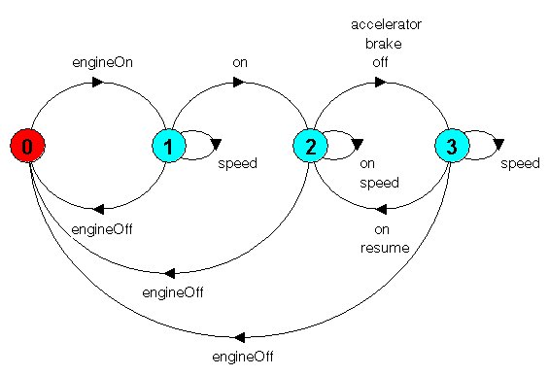
characters of these systems
The dynamic behavior of these systems can be abstracted by
a succession of steady states (enriched by invariants)
intermixed with sudden jumps (events)
Usually never halt
They are called transition systems

Slide 43
Transition system model
open(a)
deposit(a,q1)
Account={}
Account={a}
balance(a)>=0
Init
balance(a)=0
close(a)
balance(a)>=q2
withdraw(a,q2)

Slide 44
Event-B modeling components
Contexts contain the static elements
Machines contain the dynamic elements
Context
carrier sets
constants
axioms
theorems
Machine
variables
invariants
theorems
events

Slide 45
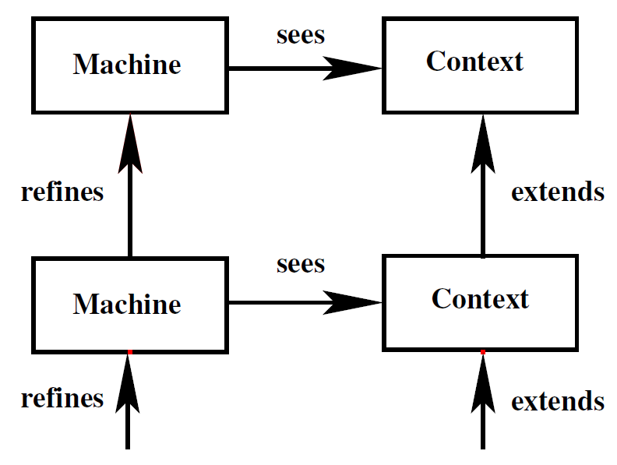
component Relationship

Slide 46
Context
carrier set:
A: set of accounts
P: set of persons
constant:
c: limit of balance
axioms:
c>0
ENV-1
ENV-2

Slide 47
Machine
Variables:
account: a set of available accounts
balance: a function from an account to its balance
owner: a function from an account to its owner person
Events:
open: open an account
close: close an account when its balance is 0
deposit: deposit money into an account
withdraw: withdraw money from an account
ENV-3
FUN-1
FUN-2
FUN-3

Slide 48
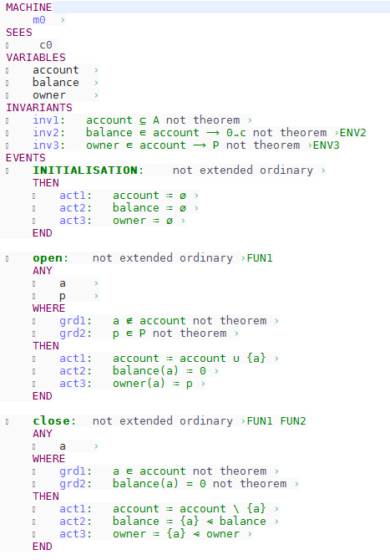
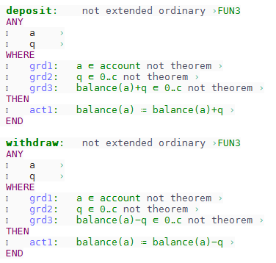
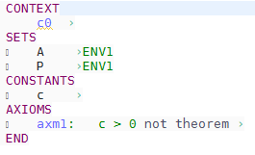

Slide 49
Refinement
Build models gradually (from abstract to concrete)
An ordered sequence of more and more precise models
Refinement preserves the required property of the abstract model
Refinement can be checked with laws
The most refined model can be automatically translated to a program

Slide 50
refining a machine
Refining Variables
introducing more variables into the observation
include more invariants to variables
Refining Events
introducing more events
strengthen guards of the abstract events
make the actions of the abstract events more deterministic

Slide 51
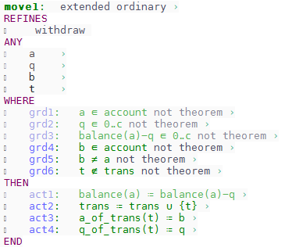
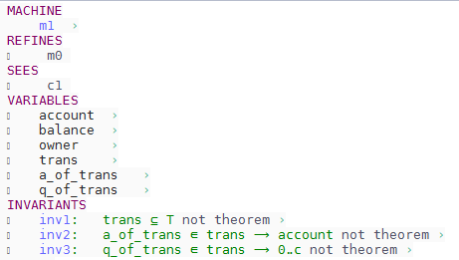
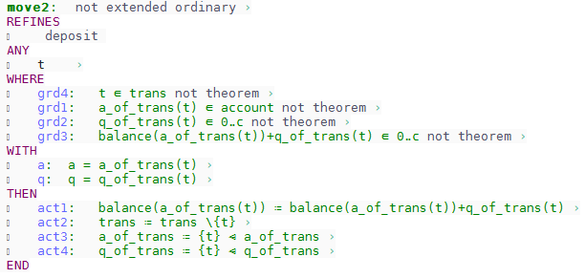
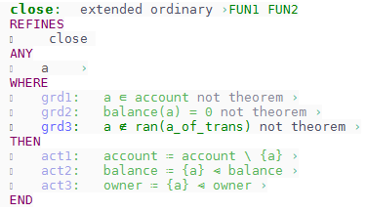
Example: Refinement

Slide 52
Proving
Allow us to debug the models
Failing proofs allow us to find missing parts of the design
What to prove
invariant preservation in every event
feasibility of each action
event refinement
convergence
deadlock freedom
etc.

Slide 53
Proof Obligations
Proof obligations are generated
when a model is constructed to keep the model consistent
When a model is refined to make the refinement correct
Proof obligations are rules that can be automatically generated
To make a formal development right, you must prove all proof obligations

Slide 54

Example: Proof obligations
Invariant preservation obligation for open
$balance⨁\left\{a⟼0\right\}∈(account∪\{a\}→0..c)$
$owner⨁\left\{a⟼p\right\}∈(account∪\{a\}→P)$
Well-definedness obligation for grd2 of close
$a∈dom\left(balance\right)∧balance∈A\text{⇸}\text{ℤ}$

Slide 55
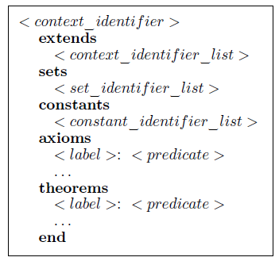
Event-B language (1)
Context structure
identifier: name of the context
extends: inherit other contexts
sets: list of user-defined carrier sets
constants: list of user-defined constants
axioms: predicates that the constants obey
theorems: a list of theorems that need to be proved

Slide 56
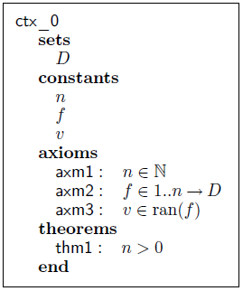
Event-B language (2)
Context Example

Slide 57
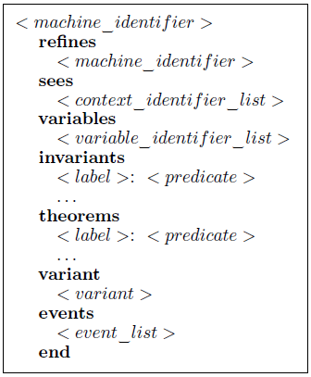
Event-B language (3)
Machine structure
identifier: name of the machine
refines: the machine that this machine refines
sees: list of contexts the machine refers
variables: list of variables used by the machine
invariants: predicates that the variables must obey
theorems: theorems that need to be proved
variant: relating convergent behaviors
events: list of events of the machine

Slide 58
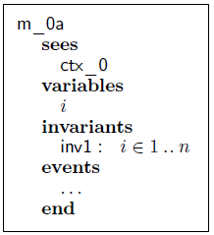
Event-B language (4)
Machine Example

Slide 59
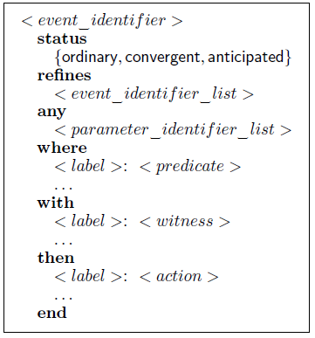
Event-B language (5)
Event structure
identifier: name of the event
status: type of the event relating convergence
refines: abstract events that this event refines
any: list of parameters of the event
where (when): the guards of the event
with: witness variables that disappearing in its abstract event
then: list of actions of the event

Slide 60

Event-B language (6)
Guards
predicate that is true when the event is observable
Actions
deterministic: $x≔\left\langle Expression\right\rangle$ $x≔x+y$
nondeterministic: $x :∈ \left\langle set_expression\right\rangle$ $x:∈\{k|f\left(k\right)=v\}$
Witness
$x:P(x)$
predicate that relates the abstract variable x to the concrete version

Slide 61
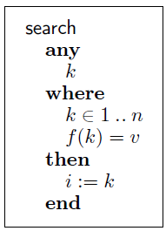
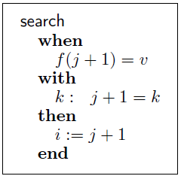
Event-B language (7)
Example of Events
Refinement

Slide 62
Summary
软件工程第一定律：精确定义用户需求
形式化开发方法：需求规范 → 抽象模型 → 程序代码
Event-B：
Requirements
Model
Refinement
Proving

Slide 63
Next Course
Event-B approach in more detail
Case study: Controlling cars on a bridge

